Slide 1

Directed Trusts
Best practices for Working with advisors, Trust protectors and excluded trustees – when to say no!
Cynthia D.M. Brown, President, Commonwealth Trust Company
David Diamond, President, The Northern Trust Company of Delaware
Michael S. Neri, Managing Director, U.S. Trust Company of Delaware
Jennifer E. Smith, McCollum D’Emilio Smith Uebler LLC

Slide 2
The Excluded Trustee

Slide 3
Excluded Cotrustee Statute
In 2017, the Trust Act was amended to add new Section 3313A
  Purpose – to provide settlors, beneficiaries, and fiduciaries of Delaware trusts with more tools, greater flexibility, and more certainty in the context of directed trusts
  Scope – addresses the duties and liability of a trustee when a trust instrument grants a cotrustee—to the exclusion of another cotrustee—exclusive authority to take specified actions
  Framework – patterned after and follows immediately after Delaware’s direction adviser statute

Slide 4
Excluded Cotrustee Statute
Intended to shore up issues arising in the context of directed trusts such as:
  When a trustee is directed to act in a manner it does not believe to be in the best interest of a beneficiary
  When it is unclear if the direction falls within the scope of an adviser’s authority
  When it is unclear whether and how the trustee should communicate with beneficiaries or other advisers about directions

Slide 5
Excluded Cotrustee Statute
Wilful misconduct standard
  “If a governing instrument confers upon a cotrustee the power to direct certain actions of the excluded trustee, the excluded trustee must act in accordance with the direction and shall have no duty to act in the absence of such direction and is not liable, individually or as a fiduciary, for any loss resulting directly or indirectly from compliance with the direction unless compliance with the direction constitutes wilful misconduct on the part of the directed cotrustee.”
  12 Del C. § 3313A(a)(1)

Slide 6
Excluded Cotrustee Statute
Compare with Directed Trustee Statute
  3313(b) provides: “If a governing instrument provides that a fiduciary is to follow the direction of an adviser or is not to take specified actions except at the direction of an adviser, and the fiduciary acts in accordance with such a direction, then except in cases of willful misconduct on the part of the fiduciary so directed, the fiduciary shall not be liable for any loss resulting directly or indirectly from any such act.”
  Section 3313A(a)(1) also uses wilful misconduct standard, but is more robust and protective

Slide 7
Excluded Cotrustee Statute
Limitation on liability of excluded cotrustee
  “If the terms of the governing instrument confer upon the cotrustee exclusive authority to exercise any power, the excluded trustee is not liable, individually or as a fiduciary, for any loss resulting directly or indirectly from the action taken by the cotrustee in the exercise of the power, such that the excluded trustee shall not be a fiduciary with respect to any power as to which the governing instrument has conferred upon the cotrustee exclusive authority in accordance with this paragraph (a)(2), but shall remain a fiduciary with respect to any powers or other matters as to which the governing instrument has not conferred exclusive authority on the cotrustee.”
  12 Del C. § 3313A(a)(2)

Slide 8
Excluded Cotrustee Statute
Compare with Directed Trustee Statute
  Directed trustee liable for wilful misconduct when following direction
  Excluded cotrustee exonerated from liability for actions or inactions of cotrustee having sole power and authority for a matter
    Higher level of protection

Slide 9
Excluded Cotrustee Statute
No duty to monitor or give advice
  “The excluded trustee has no duty to monitor the conduct of the cotrustee, provide advice to the cotrustee or consult with or request directions from the cotrustee. The excluded trustee is not required to give notice to any beneficiary of any action taken or not taken by the cotrustee whether or not the excluded trustee agrees with the result. Administrative actions taken by the excluded trustee for the purpose of implementing directions of the cotrustee, including confirming that the directions of the cotrustee have been carried out, do not constitute monitoring of the cotrustee nor do they constitute participation in decisions within the scope of the cotrustee’s authority.”
  12 Del C. § 3313A(a)(3)

Slide 10
Excluded Cotrustee Statute
Compare with Directed Trustee Statute
  Directed trustee has no duty to:
    Monitor the conduct of the adviser
    Provide advice to or consult with the adviser
    Communicate, warn or apprise any beneficiary or third party when trustee would have taken any action different from that of the direction
  Directed trustee’s administrative actions in executing directions do not amount to monitoring or participating in such actions absent clear and convincing evidence to the contrary
  Excluded trustee has no duty to:
    Take any of the above actions
    Plus eliminates “clear and convincing evidence” standard

Slide 11
Excluded Cotrustee Statute
Additional protection for excluded cotrustee
  “The cotrustee holding the power to take certain actions with respect to the trust shall be liable to the beneficiaries with respect to the trust shall be liable to the beneficiaries with respect to the exercise of the power as if the excluded trustee were not in office and shall have the exclusive obligation to account to the beneficiaries and defend any action brought by the beneficiaries with respect to the exercise of the power.”
  12 Del C. § 3313A(b)
  No corollary in Directed Trustee Statute

Slide 12
Excluded Cotrustee Statute
Potential pitfalls
  What are the limits on bifurcation?
    Rollins v. Branch Banking and Trust Company of Virginia
  How does an excluded cotrustee stay informed?
    Section 3317 – duty to keep informed

Slide 13
Excluded Cotrustee Statute
Best Practices
  Well-drafted Trust Agreement
    Reference Section 3313A
    Incorporate key language
  Getting the right players on the team
    Well-informed cotrustees and advisers
  Clear, written direction
  Representation by separate counsel

Slide 14
Concerns with Investment Direction

Slide 15

Uses for Directed Trusts
Investments (all investments or certain special holdings) – ability to follow a unique investment strategy outside a trustee’s risk tolerance
Distributions
Beneficiary Notification
Valuations with difficult to value assets
Tax Reporting
Change of Situs and Governing Law
Amendment of Trust Instrument
Any Other Matter (depending upon the flexibility of the statute)
  Under the comments to the UDTA §6, this might also include: the determination of capacity of a fiduciary; the determination of compensation for a fiduciary; the ability to prosecute, defend, or join an action or judicial proceeding, and the release of another fiduciary from liability for a proposed or taken action.

Slide 16

Information Sharing
Informational Fiduciary Duties which remain with the directed trustee, regardless of the bifurcation of responsibility with regard to investment management, include:
  Duty of record keeping
    Duty to maintain trust records in a professional manner with regular review
    A thorough understanding of the tax and financial planning goals
    Records subject to inspection by the beneficiaries and the regulators
  Duty to inform and report
    Duty to maintain accurate accountings and tax records
  Duty to safeguard trust assets
    Not from an investment selection perspective, but, to ensure assets are properly accounted for and not being improperly distributed, etc.
12 Del. C. §3317 provides:
  “…each trust fiduciary (including trustees, advisers, protectors, and other fiduciaries), and each trust nonfiduciary, has a duty upon request to keep all of the fiduciaries and nonfiduciaries for the trust reasonably informed about the administration of the trust with respect to any specific duty or function being performed by such fiduciary or nonfiduciary to the extent that providing such information to the other fiduciaries and nonfiduciaries is reasonably necessary for the other fiduciaries and nonfiduciaries to perform their duties.”

Slide 17
Other Concerns with a Lack of Information Sharing
Mandated Informational Disclosures
  Additional reporting requirements derived from CRS and FATCA
Internal Compliance
  Regulatory requirements for BSA/AML and other “know your client” issues
  Investment in high risk businesses, irregular activity, or layering occurring?
  Knowledge of suspicious activities?
Reputational concerns
  Investment in undesirable or high risk businesses (i.e. marijuana, mining, dealing in precious stones and metals)

Slide 18
Key Concerns with Excluded Trustee Relationships and Investments:
The excluded trustee (typically the administrative trustee) still needs to maintain all trust records and therefore needs copies of all bank account statements and other transactional documents for the trust records
The excluded trustee also needs these records to prepare an accurate accounting and in some cases, to prepare accurate income tax returns
The excluded trustee is typically the professional/corporate trustee and therefore the trustee with the most complete overall information regarding the proper administration of the trust
The excluded trustee may not be aware of money movement promptly, making it difficult to safeguard assets and facilitate expense payments
The trust’s situs is typically reliant upon the level of activity occurring within the chosen jurisdiction, which is typically where the excluded trustee is acting making their participation in the trust’s administration critical

Slide 19

Key Concerns with Advisers
Often, drafters take the approach that all of the investment power and authority is to be held by the adviser, and the trustee shall have no trust power and authority over investments. This is not how a directed trust is structured.
The trustee holds the trust power and authority to take actions and the direction adviser directs the trustee to exercise those powers.
Language that provides for the transference of the investment power and authority starts to look more like an excluded trustee situation with a co-trustee rather than an adviser, who may be a co-fiduciary, but, is not an owner of the trust assets.
It is always better to retain ownership in excluded trustee relationships with the directed trustee as well for the purpose of:
  Ease of receiving statements, authority to request information;
  Maintaining overall professional knowledge of trust administration; and
  Retention of complete records and maintenance of the trust’s accounting all in one place.

Slide 20
Content of Direction Letters
Direction letters should be delivered to the trustee in writing.
The direction letter should be specific and should leave no discretion to the trustee.
  For example: the direction letter should not say that “the trustee shall enter into a note upon such terms as the trustee may determine.”
The direction letter should recite relevant statutory provisions or trust provisions so the adviser clearly understands the bifurcation of the roles for each direction.
If there are documents to be signed, the direction letter should have those documents attached to it, essentially stating “sign here”.
Consider issues such as representations and warranties, no duty to monitor language, etc.
Direction letters should acknowledge and recite the on-going duties of the direction adviser within the letter, such as valuation, appointment of managers, etc.
NOTE: The trustee cannot control the form of the direction letter; however, individual trustees typically have a preferred form of letter which address specific concerns. Where the trustee actually drafts the direction letter, what are the implications? Consider 12 Del. C. §3313(e) which creates a presumption of administrative nature of any such actions.

Slide 21

Consider Adding Language to the Trust Document Itself
Such language should provide that the trustee is able to rely on representations from the Investment Adviser or Investment Trustee regarding:
  Representations and Warranties
  Determination of accredited investor or qualified investor status
  Valuation information provided with regard to closely held entities or other special holdings
  Acknowledgement of additional l responsibilities with closely held entities or other special holdings
    Directing the election of managers
    Directing the participation of the trust in management
  Acknowledging that direction letters must be in a form acceptable to the directed/excluded trustee and that any revisions to direction letters are to clarify vague or unspecific language.

Slide 22
Conflicts where not a party to investments but responsible for tax return preparation
Be careful to address these points in the trust document or other communications with the co-fiduciaries:
  The importance of information sharing is the key to ensuring accurate tax filing
  The need for full tax information from reporting financial institutions and other relevant parties to prepare accurate returns
  The need for an exchange of information regarding foreign tax reporting such as in France, Israel, etc.
  The need for information sharing regarding trust holdings which request CRS and FATCA reporting status
  The need for awareness regarding accounts which require FBAR reporting for foreign bank accounts?

Slide 23
Cross-over Transactions
What if the directed trustee is responsible for distributions and reimbursements, but, not investments? How will that effect the administration of the trust?
  Reimbursement of the grantor for taxes paid as a result of the trust’s grantor tax payments (requires both a knowledge of investments and of the trust’s tax liability)
  Transactions that may qualify as both an investment decision and a distribution decision:
    KEY EXAMPLE: loans to beneficiaries.
  Payment of expenses when all funds are held at the entity level. How does the trustee get liquid funds to pay the trust expense?
  Conflicting trust needs, for example a distribution request is made at the same time that an insurance premium is due and there are two separate advisers directing investments and distributions. Both direct the trustee to act.

Slide 24
Concerns with Distribution Direction

Slide 25
What is a Distribution Advisor?
Delaware Title 12 Section 3313 – Same familiar statute that creates the Investment Advisor
A fiduciary (or non-fiduciary) role where a person directs the trustee to make discretionary distributions to a trust beneficiary
Liability standard = willful misconduct
Trustee is NOT responsible for monitoring conduct of Distribution Advisor, providing advice or communicating with beneficiary on how the trustee would treat a directed distribution
Directed trustee must be comfortable that the directed distribution is permitted by the trust agreement

Slide 26
The Distribution Advisor Role
Individual
  Usually a close friend or family member who personally knows the beneficiaries
Corporate or LLC
  Helpful when there are continuity concerns – law or accounting firm
  Alternative to consider when fiduciary contacts with a state need to be eliminated – Grantor is Fiduciary Distribution Advisor
  Minimize liability concerns of individuals who wish to otherwise serve as the Distribution Advisor
Committee
  DING trust – Adverse parties
  Shared family decision-making

Slide 27

Communication with the Trustee
Direction Letter
  Written
  Signed by Distribution Advisor
  Includes:
    Name of Beneficiary
    Purpose for distribution and confirmation it meets trust distribution standards
    Identification of cash/assets being distributed
    Delivery instructions
  Supporting Documents
    Invoices, budgets, tax returns

Slide 28
Why Have a Distribution Advisor?
Complex dispositive provisions
  Formulas – Examples include where a percentage of a beneficiary’s income less a fixed amount with COLA but only if they do not receive a distribution from another trust, etc.
  Incentive provisions – Trust allows for distributions if gainfully employed, productive member of society, not abusing alcohol or drugs. How is a corporate trustee able to administer these provisions without personal knowledge?
  Special needs –
    Corporate trustee without personal knowledge of beneficiary often will not know if or when a beneficiary has special needs.
    Many corporate trustees will not administer trusts for beneficiaries with existing special needs due to increased administrative burdens. A Distribution Advisor with special needs experience can assume those administrative burdens.

Slide 29
Why Have a Distribution Advisor?
Complex family situations
  More intimate knowledge of the family/beneficiaries – Can apply certain dispositive standards better than corporate fiduciary – “Best Interests”, “Standard of Living” at time the trust was created, knowledge of outside resources or other pending gifts or trusts
  Sensitive issues – Distributions limited if no living with spouse, pre-marital planning required
  Consistent with family’s value system – Distributions made based on religious law

Slide 30

Other Considerations
Distribution directed for purpose not allowed by the trust agreement
  Trust agreement prohibits distributions to purchase boats, cars or airplanes
Directed Distribution delivered to Trustee, but there is no cash available
  Coordination required with Investment Advisor to raise cash
  What happens when asset cannot be liquidated or the Investment Advisor is unwilling to sell or make an LLC distribution?

Slide 31
Other Considerations
Decanting Trusts
  Distribution Advisor must provide direction - Trustee should consider a more robust direction letter
Beneficiary Loan made by Investment Advisor
  Distribution Advisor should be informed in the event of non-payment of loan it may need to be re-classified as a directed distribution
Distributions of non-marketable assets – IA approval?
  Trustee should consider requiring a more robust direction letter where the Distribution and/or Investment Advisor assume any representations and warranties associated with the asset transfer

Slide 32

Other Considerations
Distribution Committee that includes the trustee – good idea or not?
  If a corporate trustee dissents from a distribution decision agreed to by the individual committee members would it be considered evidence of negligence if later reviewed by a court?

Slide 33
Concerns with Income Tax Returns

Slide 34
Tax compliance without a directed trust
Trustee is responsible for tax compliance including preparing and filing returns, and making tax payments.
Sometimes at the request of the client, preparation of tax returns is done by an outside preparer.
    This may lead to the trustee receiving returns close to filing deadline, and having to review under a short timeframe.
    Trustee signs the returns, even though the outside preparer completed the returns.
    Trustee signs under penalties of perjury.

Slide 35
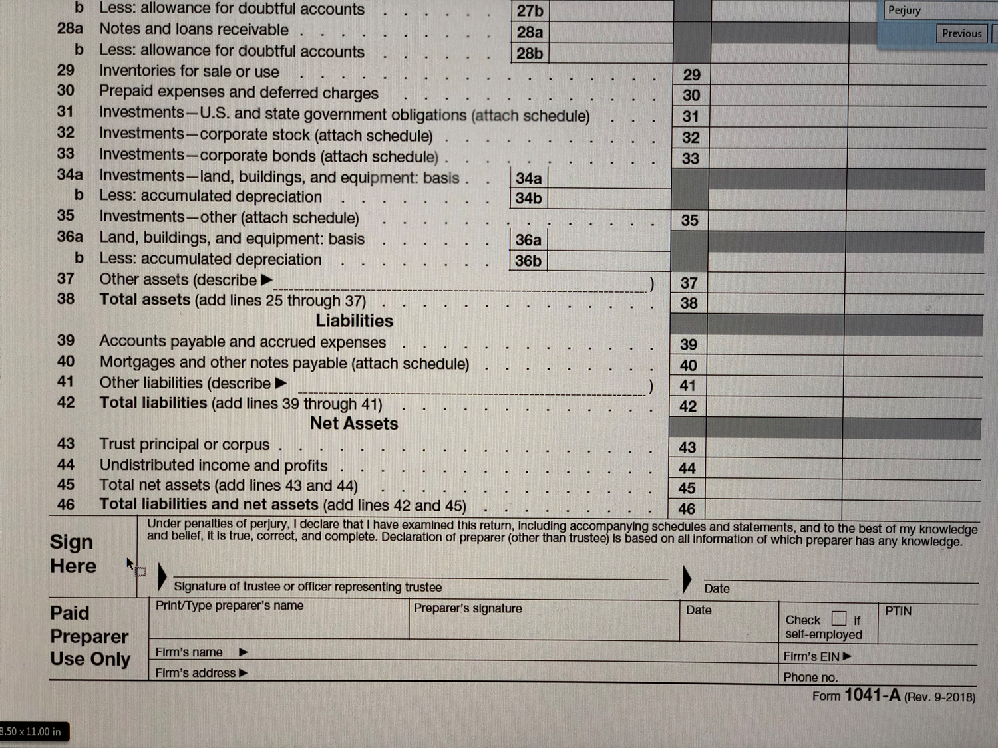
Under penalties of perjury …

Slide 36
What are the penalties for perjury?
26 USC Section 7207
(misdemeanor)
  Anyone who willfully delivers or discloses to the [IRS] any list, statement or other document, known by him to be fraudulent or to be false as to any material matter, shall be fined not more than $1,000, or imprisoned not more than 1 year, or both.
26 USC Section 7206(1)
(felony)
  Anyone who willfully makes and subscribes any return, statement, or other document, which contains or is verified by a written declaration that it is made under the penalties of perjury, and which he does not believe to be true and correct as to every material matter shall... be guilty of a felony and, upon conviction thereof, shall be fined not more than $5,000, or imprisoned not more than 3 years, or both, together with the costs of prosecution.

Slide 37
Could a directed trust structure help?
Under 12 Del. C. §3313 the trustee could be directed by an advisor (perhaps the “Tax Advisor”) on all tax compliance matters.
Outside preparer could complete the return, and Tax Advisor could send the return with a direction letter directing the Trustee to (i) file the specified return, and (ii) make specified tax payment.
Note that the trustee still signs the return under penalties of perjury.
To address this, the letter of direction could have language where the Tax Advisor represents to the trustee that all information contained on the return and accompanying schedules is true, correct and complete, and that the Tax Advisor indemnifies the trustee for any liability associated with the filing.

Slide 38
Could an administrative trust structure help?
Under 12 Del. C. §3313A there could be a Tax Trustee which is separate from the Administrative Trustee.
Note that the Administrative Trustee could also be the Investment Trustee and / or the Distribution Trustee.
Here the Tax Trustee is completely responsible for all tax compliance including the preparation, review, and filing of the returns - as well as the payment of tax.
It would be necessary to coordinate the payment of tax.
  Will the Tax Trustee have a separate account holding funds to pay the tax?
  Will the Tax Trustee still direct the Administrative Trustee on the transfer of funds or payment of the tax?
In all instances, it will be necessary to coordinate with the Investment Trustee (which may be the Administrative Trustee) to make sure that liquidity is available for payment of tax due.

Slide 39
Perhaps there is a different view on tax a filing position.
Is there agreement on what state filings are required?
  Does a fiduciary, beneficiary, grantor, or other factor cause state filing and / or taxation?
  What about source income in any given state – does that cause state filing and/or taxation, and if so based on what amount? Does a minimal amount of source income cause taxation in the given state?
Has the trust been decanted, and if so is there agreement on the tax status of the second trust?
Grantor or nongrantor trust?
Taxable termination for GST purposes?
Agreement on the calculation of tax due, or of the amount of estimate that should be made?
Calculation of period for 65 Day Election?
Foreign trust or domestic trust?
Has the trust received any undistributed net income (UNI) from a foreign trust?

Slide 40
Could a directed trust structure help?
Possibly.
However if the trustee does not agree with the filing position it is being directed to take, is this different than not agreeing with an investment or distribution direction?
Could this rise to wilfull misconduct on the part of the trustee?
The trustee is still signing the returns under penalties of perjury.

Slide 41
Could an administrative trust structure help?
Possibly.
Under §3313A there is no wilfull misconduct standard for the Administrative Trustee. The responsibility and liability would rest solely with the Tax Trustee.
The Tax Trustee would sign the returns, so the Administrative Trustee should not have to be concerned with the penalties of perjury.
But what if the Internal Revenue Service determines that a tax is due that was not paid?
  Can the Service seek payment and/or assess penalties against whichever trustee has custody of the trust assets (e.g., the Administrative Trustee)?
  Consider including language in the trust instrument that addresses this.

Slide 42
Consider additional language in trust instrument
Note: This language is included for illustrative purposes only and should not be relied upon without advice from an attorney who is familiar with the client’s situation.
Directed trustee
The Trustee shall not be liable for relying on any directions from the Tax Advisor concerning tax elections, filings, payments, or any related tax compliance as defined in this trust instrument. All taxes and related interest and penalties that are attributable to any trust created under this agreement and payable by the trust (including but not limited to any tax caused by distributions received from other trusts) shall be paid from the assets held in the trust to which the tax is attributed. In no instance shall the trustee be personally liable for the payment of any tax attributable to and/or payable by any trust created under this agreement nor any interest or penalties associated with such tax. The Tax Advisor agrees to indemnify the Trustee for any such liabilities incurred by the Trustee.
Administrative trustee
The Tax Trustee shall have sole responsibility for all matters relating to tax compliance as defined in this trust agreement. The Administrative Trustee shall not have any responsibility for nor be liable for any actions regarding tax compliance as defined in this trust agreement. In no instance shall the Administrative Trustee be personally liable for the payment of any tax attributable to and/or payable by any trust created under this agreement nor any interest or penalties associated with such tax. The Tax Trustee agrees to indemnify the Administrative Trustee for any liabilities incurred by the Trustee.

Slide 43
Putting it all together
The directed trust structure, and more recently the administrative trustee structure, may address timing issues as well as differences of opinion as to filing positions.
Whether directed trust or administrative trust – coordination between all parties is important.
Before taking a directed trustee role as to tax compliance, the trustee should have an idea of the potential filing position issues that could arise, and be comfortable with its role before signing on.

Slide 44
Disclosures
The opinions discussed in today’s presentation are those of the authors and do not necessarily reflect the views of the authors’ employer. This information is not intended to be and should not be treated as legal advice or tax advice and is for informational purposes only. All information discussed herein is current only as of the date appearing in this material and is subject to change at any time without notice.

